Slide 1
CSIT 5410 (Spring 2020)
Assignment 3 – Image stitching
Jierong WANG
jwangdh@connect.ust.hk

Slide 2
Task 1 – Cylindrical Projection

Slide 3
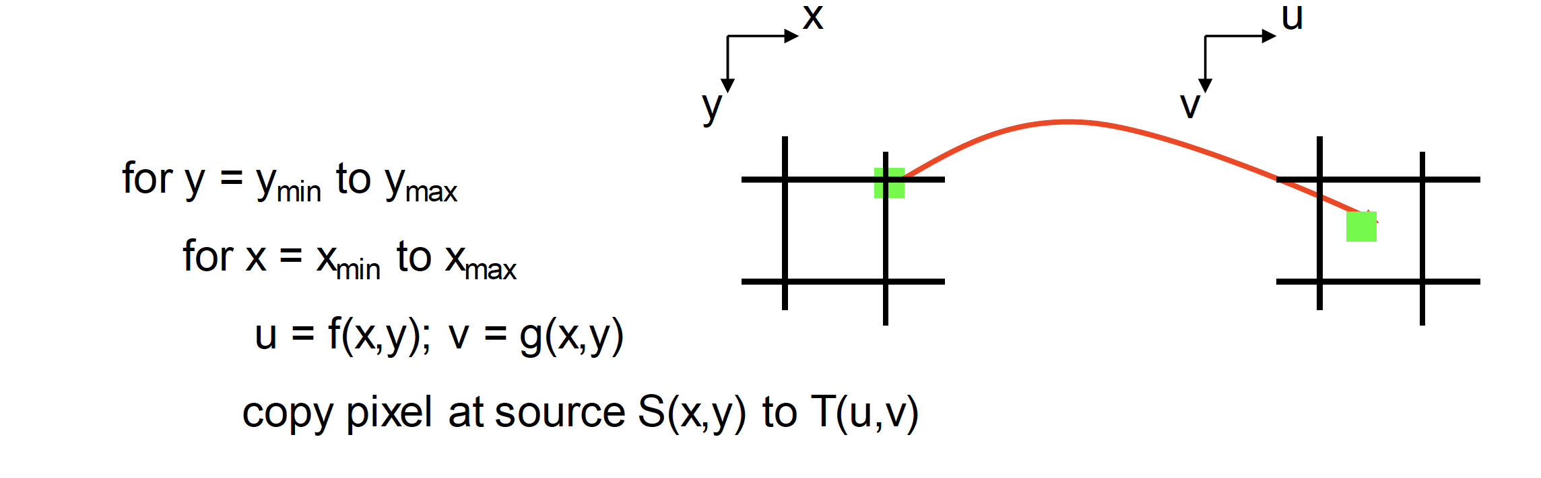
Task 1 – Cylindrical Projection
Forward mapping
Iterate over source, sending pixels to destination
Holes may be generated during construction since some points in the target image may not be hit.

Slide 4
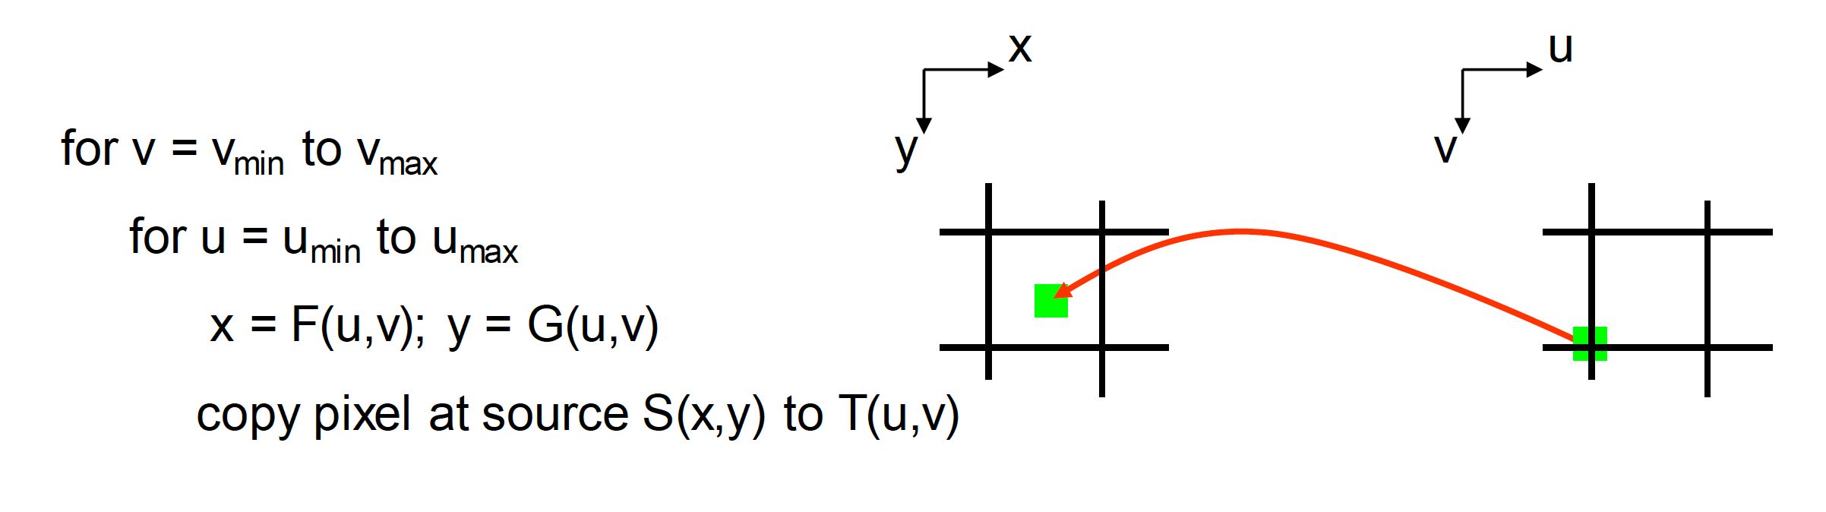
Reverse mapping
Iterate over destination, finding pixels from source.
Non-integer coordinates: interpolation (Nearest, Bilinear, Bicubic…)
No holes, better than forward mapping
Task 1 – Cylindrical Projection

Slide 5
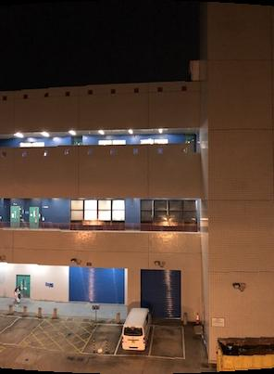
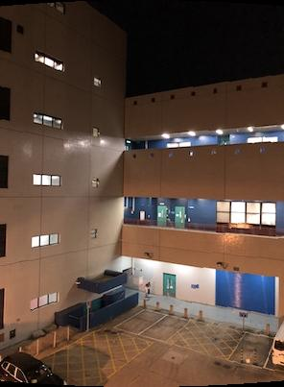
Task 1 – Cylindrical Projection

Slide 6
Task 2 – Corner Point Detection & Feature Description
Harris Corner Points
Feature Description
Use a local region centered at the detected point
Compute N statistic values from it: mean, variance, normalized intensity values…
Or region-based features such as LBP…
For each corner point, the descriptor is a column vector whose size is depend on the number of features you use.

Slide 7
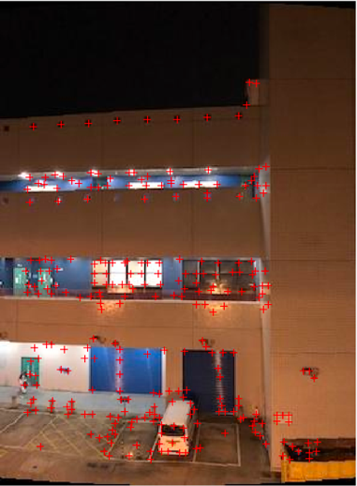
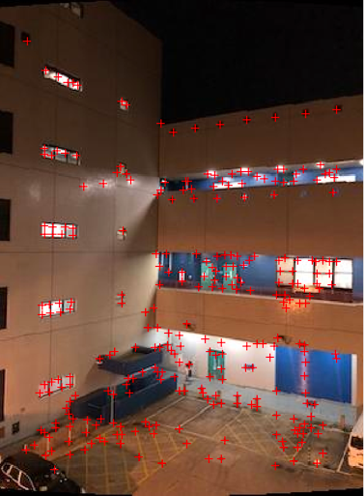
Task 2 – Corner Point Detection & Feature Description

Slide 8
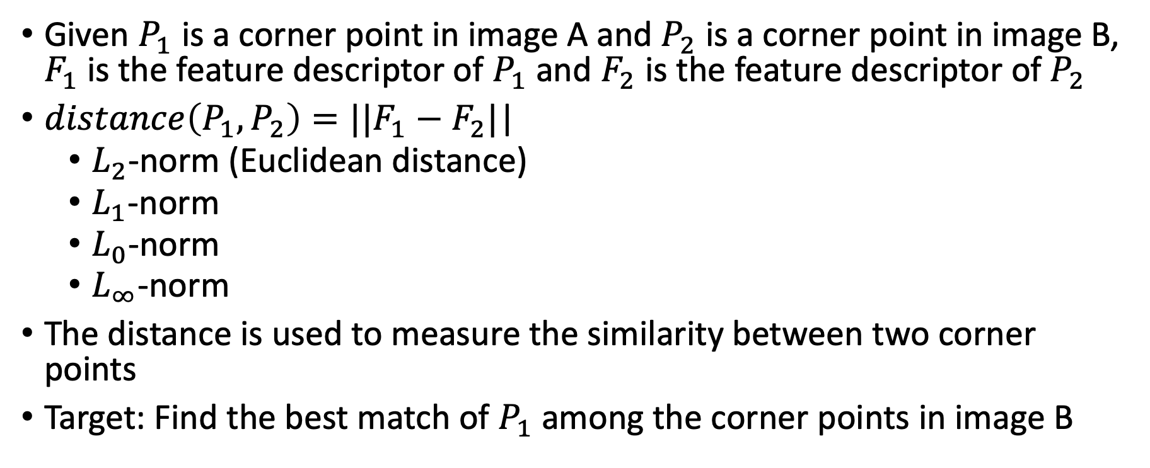
Task 3 – Distance Matching
Given $P_{1}$ is a corner point in image A and $P_{2}$ is a corner point in image B, $F_{1}$ is the feature descriptor of $P_{1}$ and $F_{2}$ is the feature descriptor of $P_{2}$
$distance\left(P_{1},P_{2}\right)=||F_{1}−F_{2}|$|
$L_{2}$-norm (Euclidean distance)
$L_{1}$-norm
$L_{0}$-norm
$L_{∞}$-norm
The distance is used to measure the similarity between two corner points
Target: Find the best match of $P_{1}$ among the corner points in image B

Slide 9
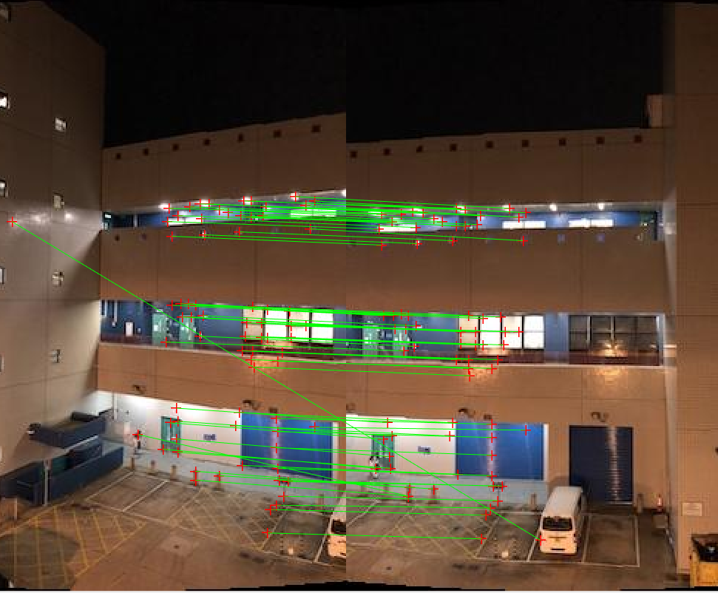
Task 3 – Distance Matching

Slide 10
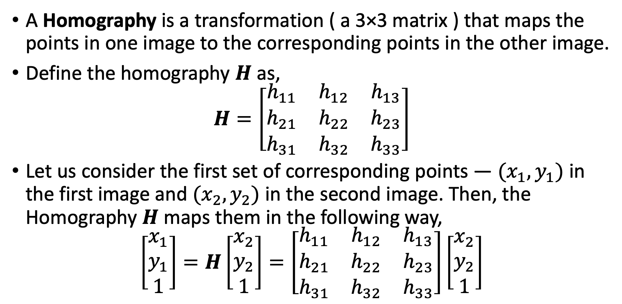
Task 4 – Random Sample Consensus(RANSAC)
A Homography is a transformation ( a 3×3 matrix ) that maps the points in one image to the corresponding points in the other image.
Define the homography $H$ as,
$$H=\left[\begin{matrix}h_{11} & h_{12} & h_{13} \\ h_{21} & h_{22} & h_{23} \\ h_{31} & h_{32} & h_{33}\end{matrix}\right]$$
Let us consider the first set of corresponding points — $(x_{1},y_{1})$ in the first image and $(x_{2},y_{2})$ in the second image. Then, the Homography $H$ maps them in the following way,
$$\left[\begin{aligned}x_{1} \\ y_{1} \\ 1\end{aligned}\right]=H\left[\begin{aligned}x_{2} \\ y_{2} \\ 1\end{aligned}\right]=\left[\begin{matrix}h_{11} & h_{12} & h_{13} \\ h_{21} & h_{22} & h_{23} \\ h_{31} & h_{32} & h_{33}\end{matrix}\right]\left[\begin{aligned}x_{2} \\ y_{2} \\ 1\end{aligned}\right]$$

Slide 11
Task 4 – Random Sample Consensus(RANSAC)
Target: Find the transformation matrix H (homography)
Let’s not match all features, but only those that have “similar enough” matches (Inliers). How can we do it?
SSD(patch1, patch2) < threshold
Least square fit? Least square fit is to find an “average” translation vector
How do we do about the bad matches (Outliers)?
Let’s look up at a simpler example: linear regression…

Slide 12
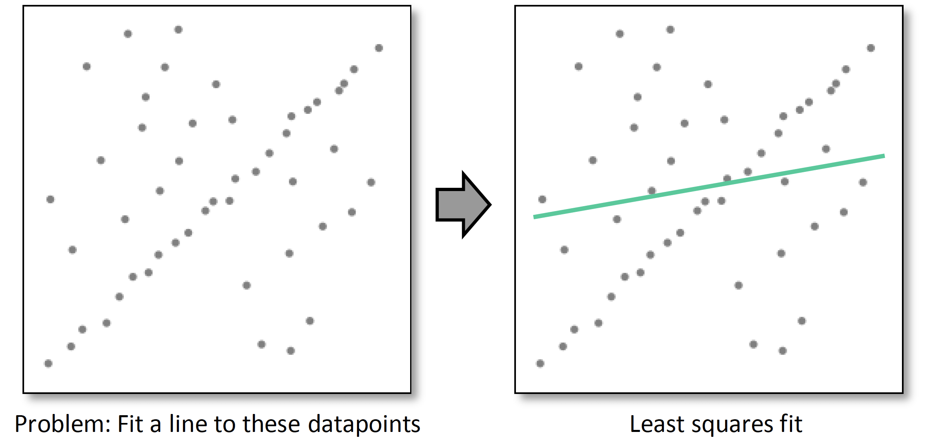
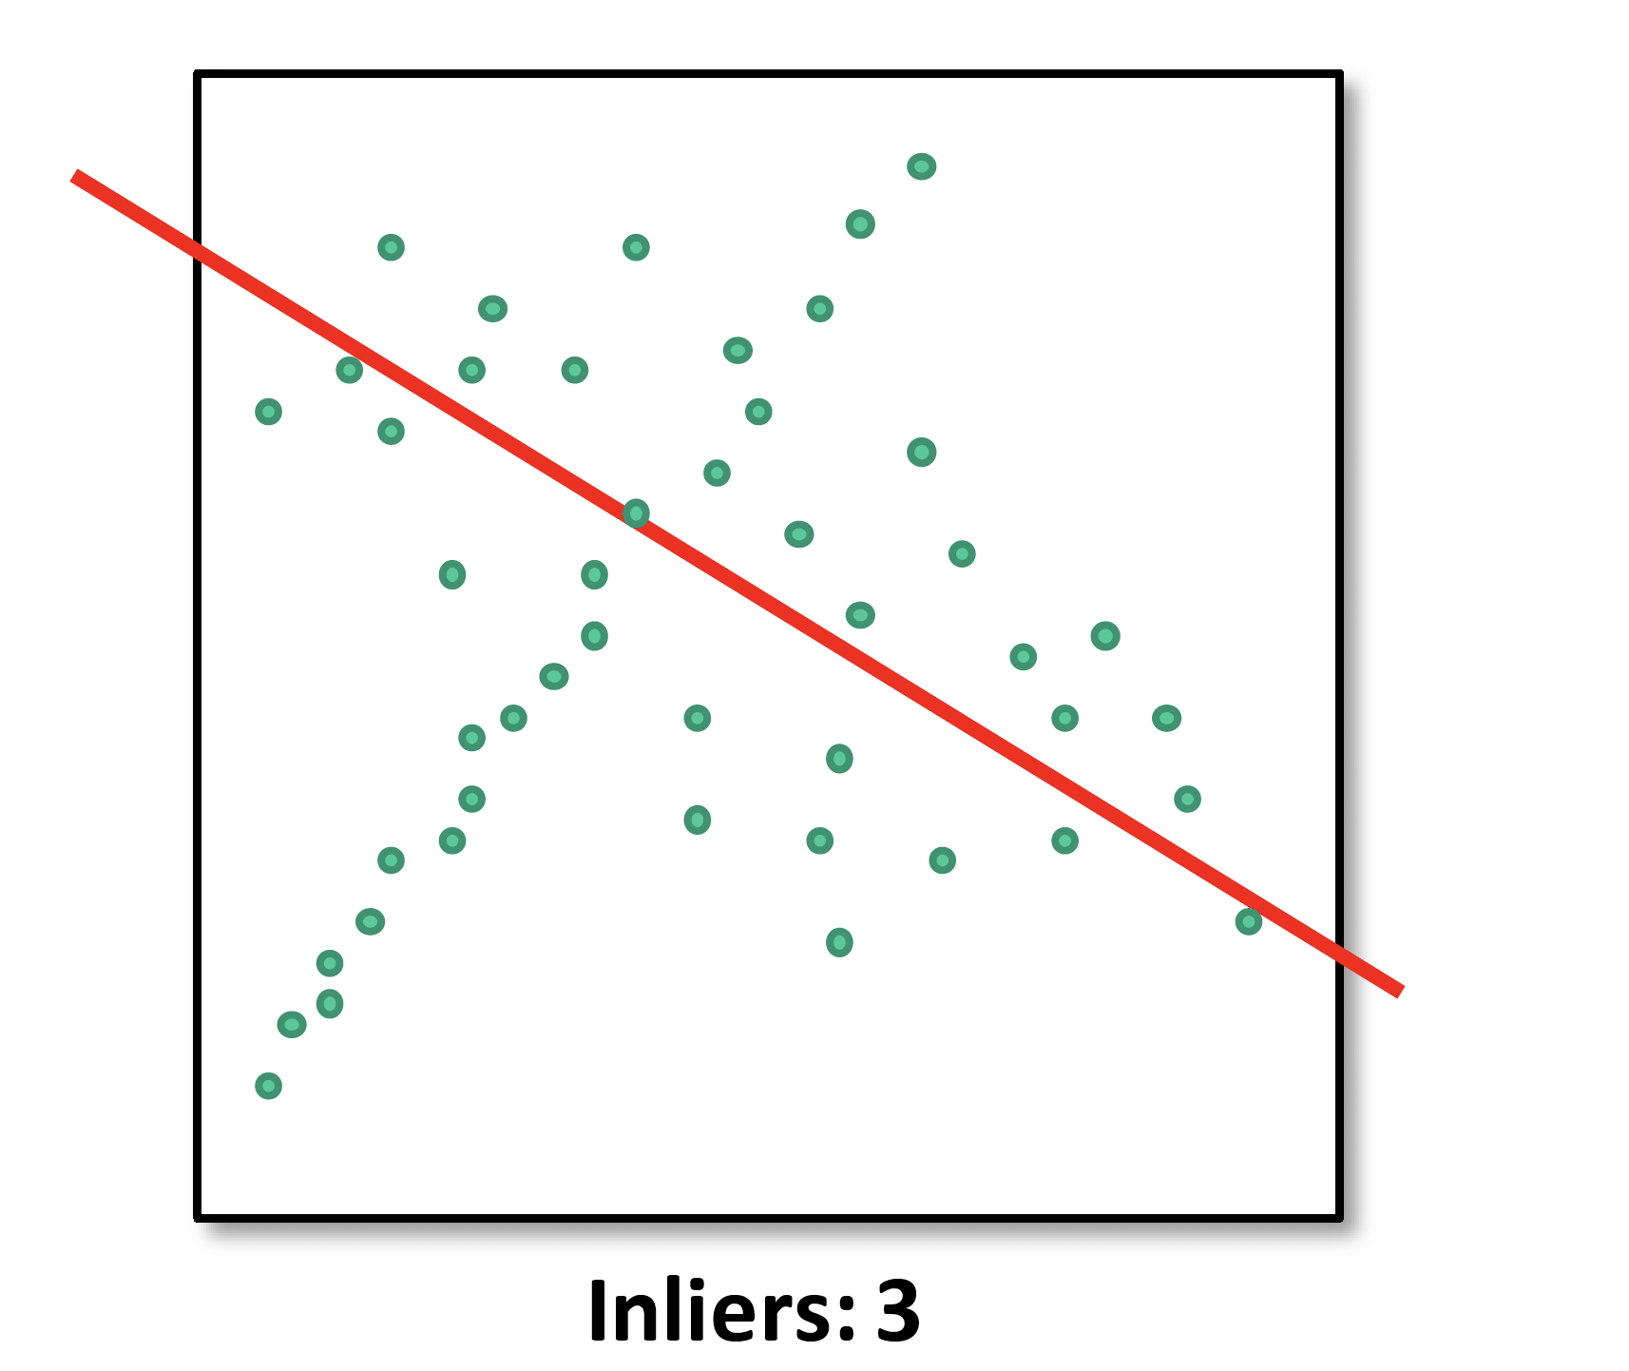
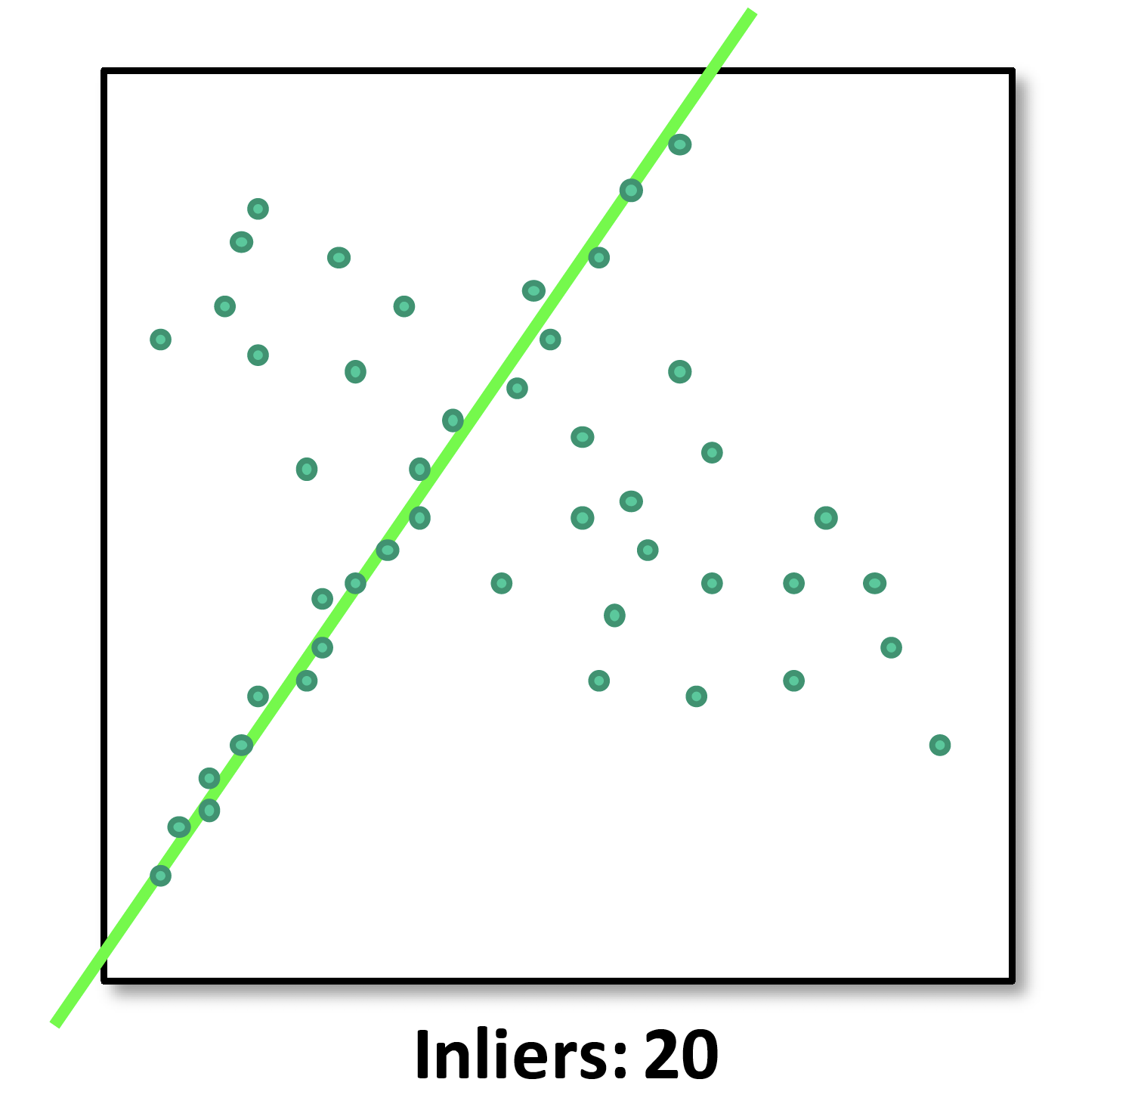
Task 4 – Random Sample Consensus(RANSAC)
Counting inliers
(Inliers: points that close enough to the line)
Hypothesize-and-test:
Try out many lines, keep the best one
Which lines?

Slide 13
Task 4 – Random Sample Consensus(RANSAC)
RANSAC
Idea: All the inliers will agree with each other on the translation vector; the (hopefully small) number of outliers will (hopefully) disagree with each other
Inlier threshold: relates to the amount of noise we expect in inliers
Number of rounds: relates to the percentage of outliers we expect and the probability of success we would like to guarantee.

Slide 14
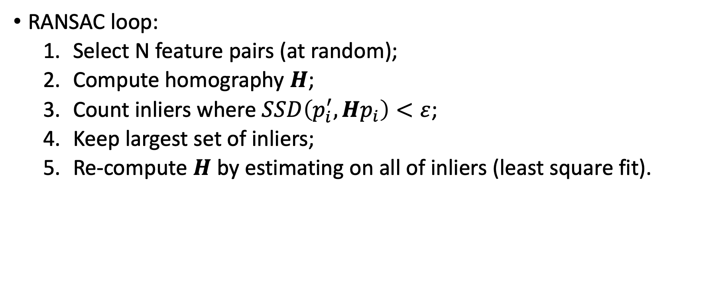
Task 4 – Random Sample Consensus(RANSAC)
RANSAC loop:
Select N feature pairs (at random);
Compute homography $H$;
Count inliers where $SSD\left(p_{i}^{′},Hp_{i}\right)<ε$;
Keep largest set of inliers;
Re-compute $H$ by estimating on all of inliers (least square fit).

Slide 15
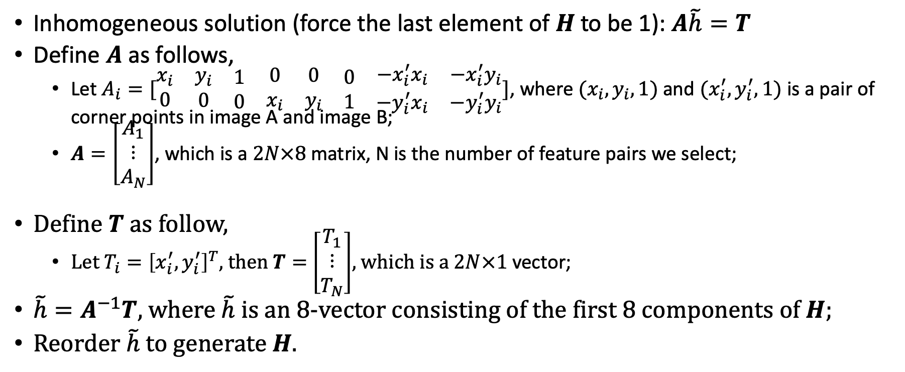
Task 4 – Random Sample Consensus(RANSAC)
Inhomogeneous solution (force the last element of $H$ to be 1):$A\tilde{h}=T$
Define $A$ as follows,
Let $A_{i}=[\begin{matrix}\begin{matrix}\begin{matrix}\begin{matrix}x_{i} \\ 0\end{matrix} & \begin{matrix}y_{i} \\ 0\end{matrix}\end{matrix} & \begin{matrix}\begin{matrix}1 \\ 0\end{matrix} & \begin{matrix}0 \\ x_{i}\end{matrix}\end{matrix}\end{matrix} & \begin{matrix}\begin{matrix}\begin{matrix}0 \\ y_{i}\end{matrix} & \begin{matrix}0 \\ 1\end{matrix}\end{matrix} & \begin{matrix}\begin{matrix}−x_{i}^{′}x_{i} \\ −y_{i}^{′}x_{i}\end{matrix} & \begin{matrix}−x_{i}^{′}y_{i} \\ −y_{i}^{′}y_{i}\end{matrix}\end{matrix}\end{matrix}\end{matrix}]$, where $(x_{i},y_{i},1)$ and $(x_{i}^{′},y_{i}^{′},1)$ is a pair of corner points in image A and image B;
$A=\left[\begin{matrix}A_{1} \\ ⋮ \\ A_{N}\end{matrix}\right]$, which is a $2N×8$ matrix, N is the number of feature pairs we select;
Define $T$ as follow,
Let $T_{i}={\left[x_{i}^{′},y_{i}^{′}\right]}^{T}$, then $T=$ $\left[\begin{matrix}T_{1} \\ ⋮ \\ T_{N}\end{matrix}\right]$, which is a $2N×1$ vector;
$\tilde{h}=A^{−1}T$, where $\tilde{h}$ is an 8-vector consisting of the first 8 components of $H$;
Reorder $\tilde{h}$ to generate $H.$

Slide 16
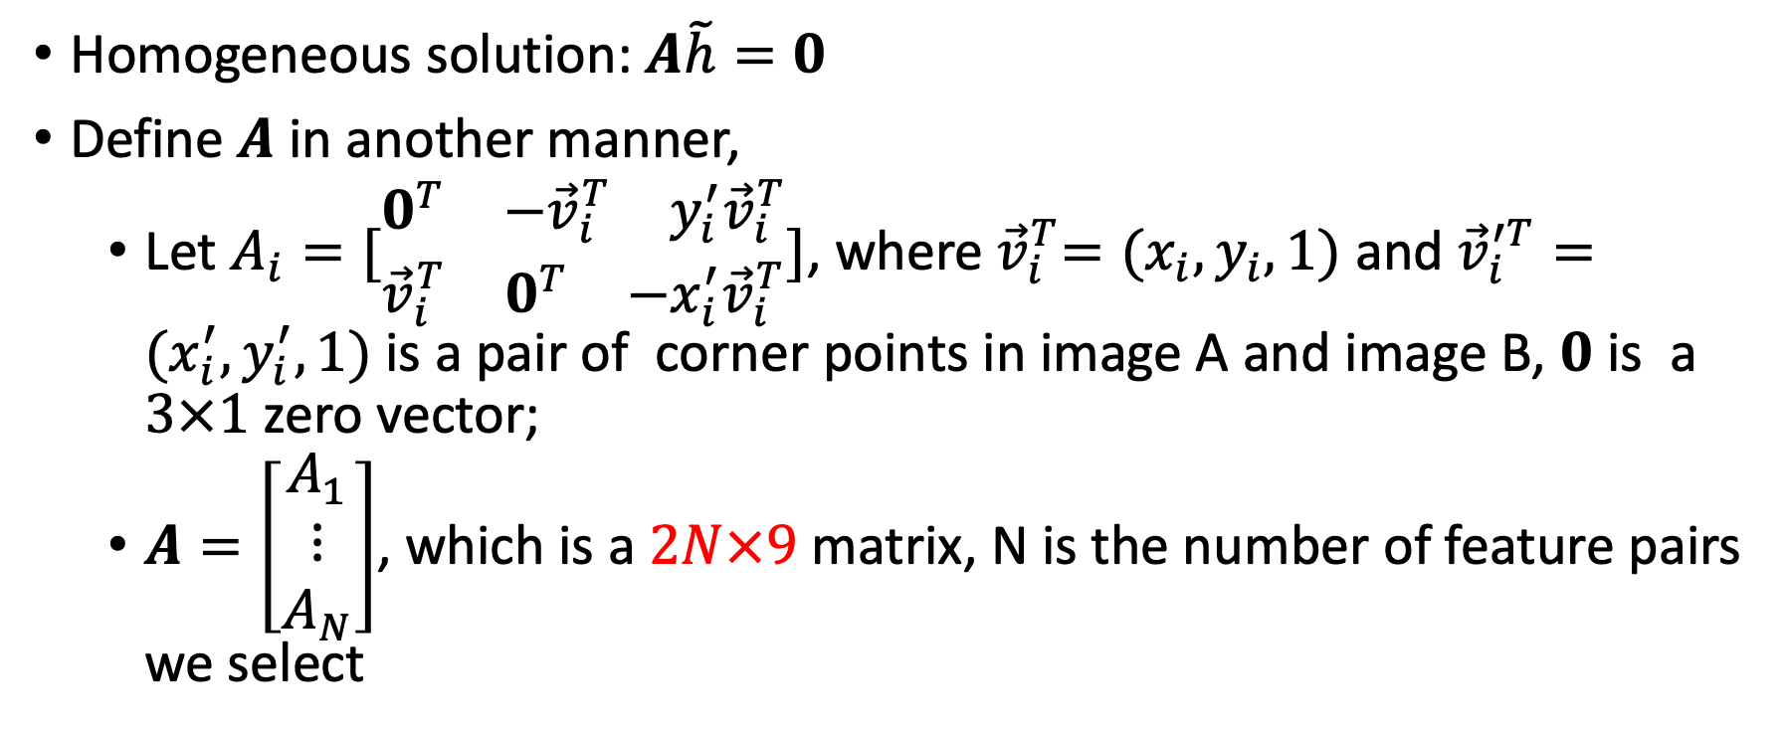
Task 4 – Random Sample Consensus(RANSAC)
Homogeneous solution: $A\tilde{h}=0$
Define $A$ in another manner,
Let $A_{i}=[\begin{matrix}\begin{matrix}0^{T} & {−\vec{v}}_{i}^{T} & y_{i}^{′}{\vec{v}}_{i}^{T}\end{matrix} \\ \begin{matrix}{\vec{v}}_{i}^{T} & 0^{T} & −x_{i}^{′}{\vec{v}}_{i}^{T}\end{matrix}\end{matrix}]$, where${ \vec{v}}_{i}^{T}=(x_{i},y_{i},1)$ and${\vec{v}}_{i}^{′T}=(x_{i}^{′},y_{i}^{′},1)$ is a pair of corner points in image A and image B, $0$ is a $3×1$zero vector;
$A=\left[\begin{matrix}A_{1} \\ ⋮ \\ A_{N}\end{matrix}\right]$, which is a $2N×9$ matrix, N is the number of feature pairs we select

Slide 17
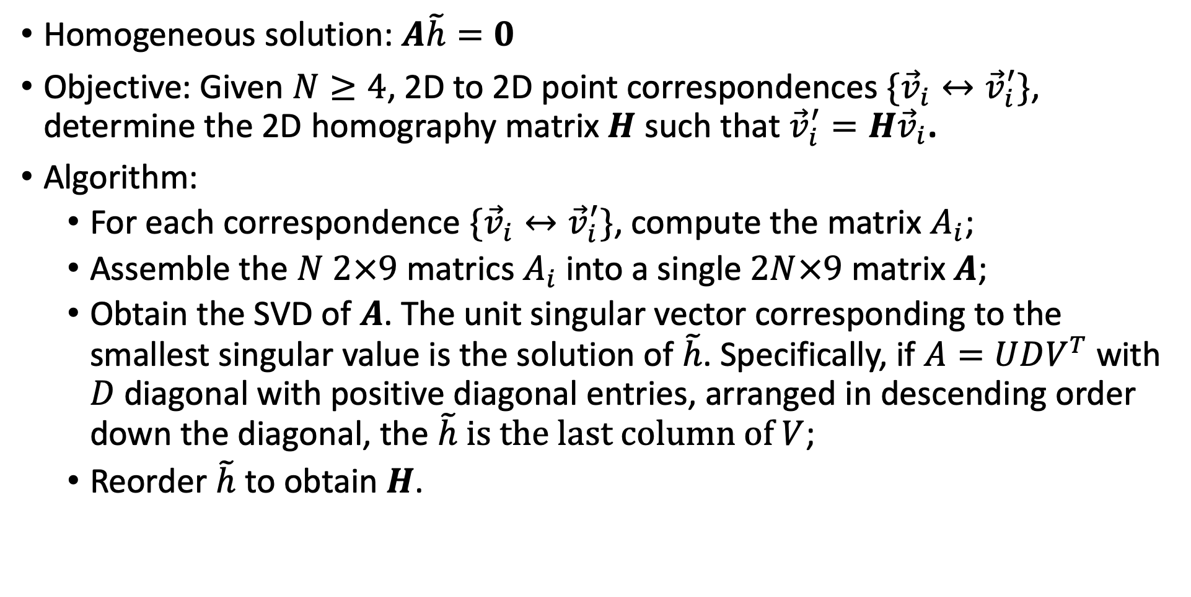
Task 4 – Random Sample Consensus(RANSAC)
Homogeneous solution: $A\tilde{h}=0$
Objective: Given $N≥4$, 2D to 2D point correspondences $\{{\vec{v}}_{i}↔{\vec{v}}_{i}^{′}\}$, determine the 2D homography matrix $H$ such that ${\vec{v}}_{i}^{′}=H{\vec{v}}_{i}$.
Algorithm:
For each correspondence $\{{\vec{v}}_{i}↔{\vec{v}}_{i}^{′}\}$, compute the matrix $A_{i}$;
Assemble the $N$ $2×9$ matrics $A_{i}$ into a single $2N×9$ matrix $A$;
Obtain the SVD of $A$. The unit singular vector corresponding to the smallest singular value is the solution of $\tilde{h}$. Specifically, if $A=UDV^{T}$ with $D$ diagonal with positive diagonal entries, arranged in descending order down the diagonal, the $\tilde{h}$ is the last column of $V$;
Reorder $\tilde{h}$ to obtain $H$.

Slide 18
Task 4 – Random Sample Consensus(RANSAC)
Reference
Multiple View Geometry in Computer Vision”, Second Edition. Richard Hartley and Andrew Zisserman, Cambridge University Press, March 2004.
Chapter 4. PP89 - 91

Slide 19
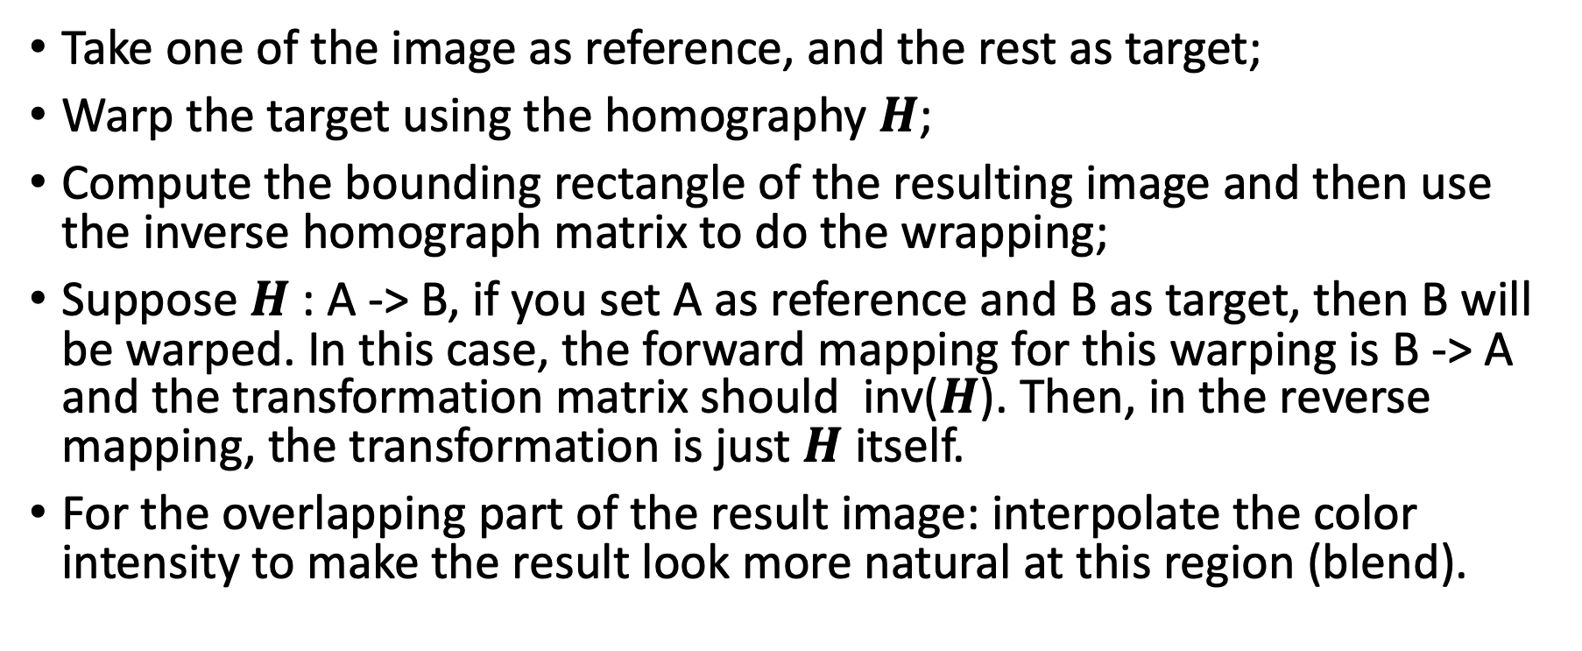
Task 5 – Merge
Take one of the image as reference, and the rest as target;
Warp the target using the homography $H$;
Compute the bounding rectangle of the resulting image and then use the inverse homograph matrix to do the wrapping;
Suppose $H$: A -> B, if you set A as reference and B as target, then B will be warped. In this case, the forward mapping for this warping is B -> A and the transformation matrix should inv($H$). Then, in the reverse mapping, the transformation is just $H$ itself.
For the overlapping part of the result image: interpolate the color intensity to make the result look more natural at this region (blend).

Slide 20
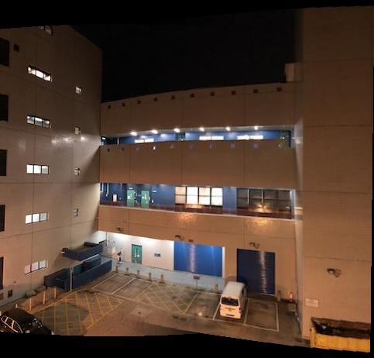
Task 5 – Merge

Slide 21
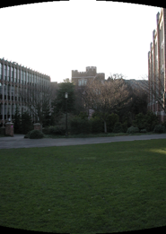
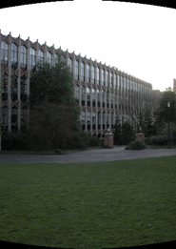
Another Example – Cylindrical Projection

Slide 22
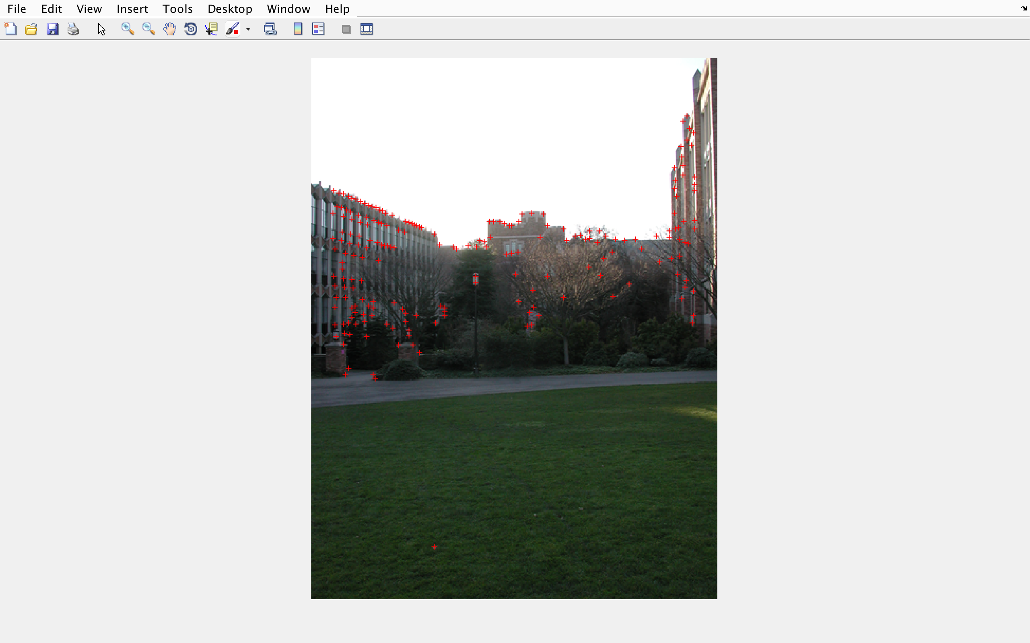
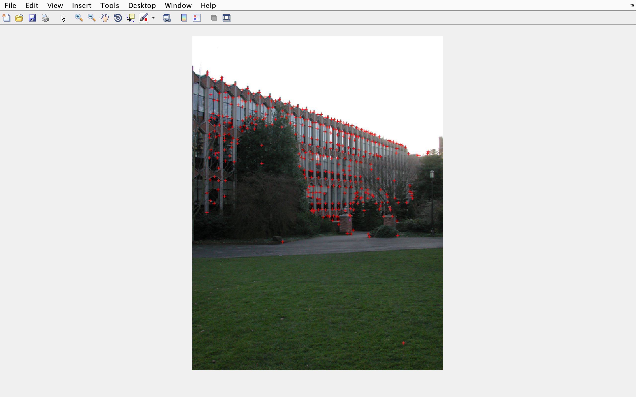
Another Example – Corner Points Detection

Slide 23
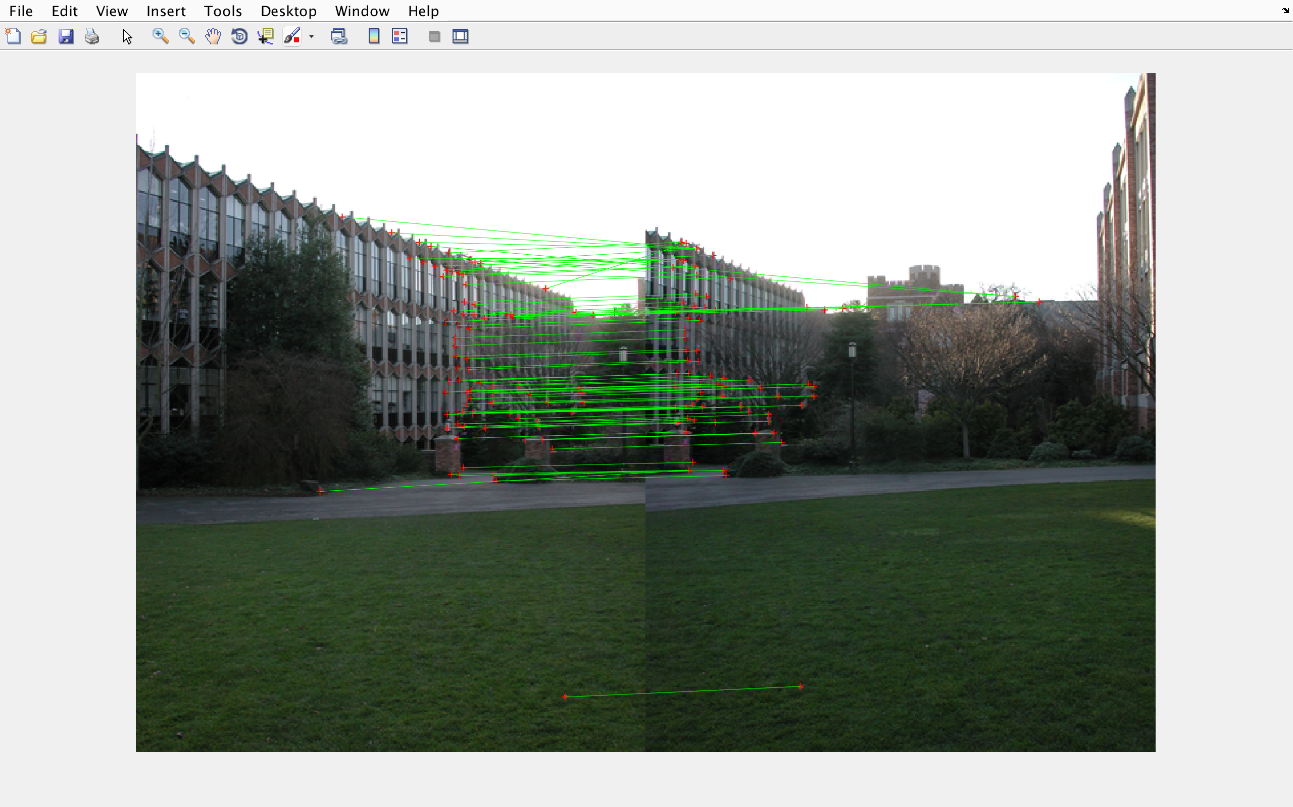
Another Example – Matching

Slide 24
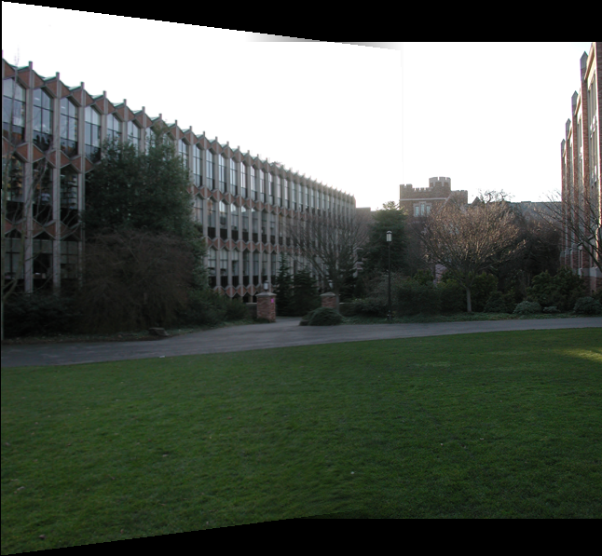
Another Example – Stitching Results without Cylindrical Projection

Slide 25
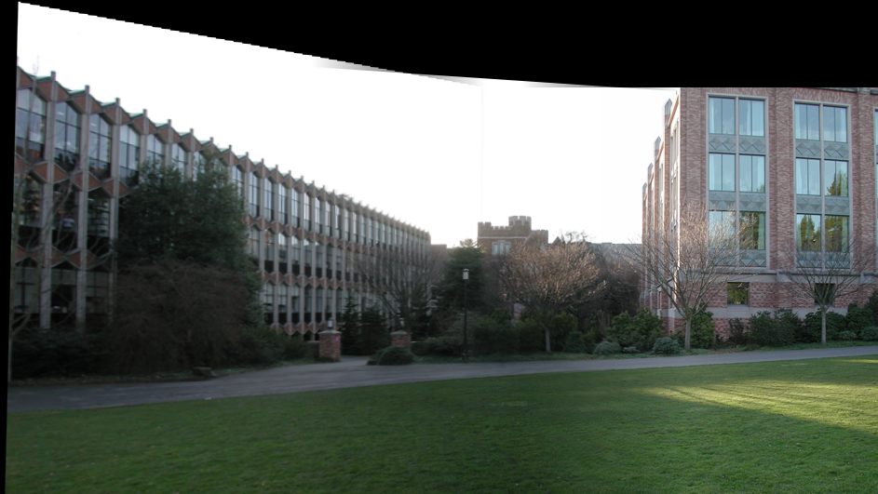
Another Example – Stitching Results without Cylindrical Projection

Slide 26
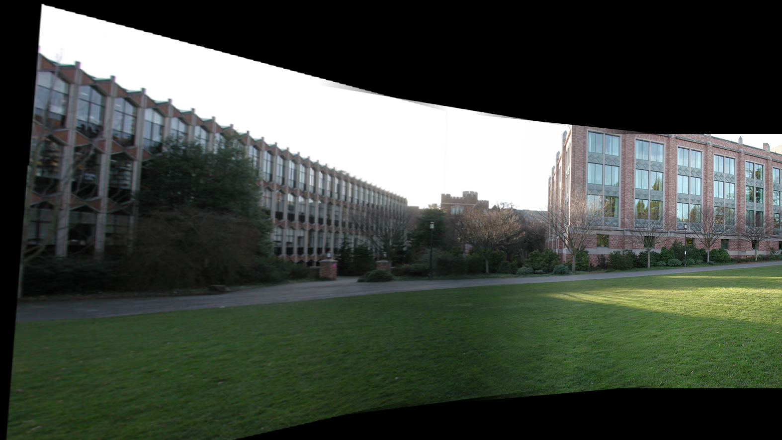
Another Example – Stitching Results without Cylindrical Projection

Slide 27
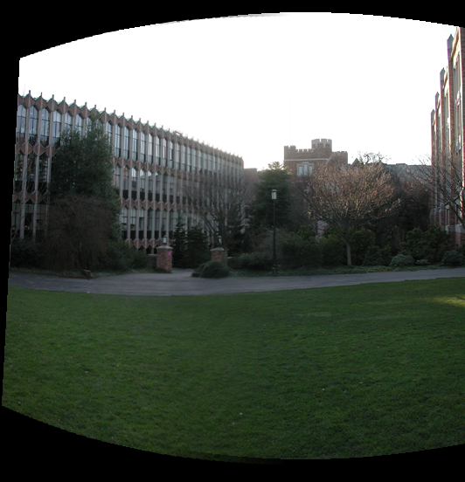
Another Example – Stitching Results with Cylindrical Projection

Slide 28
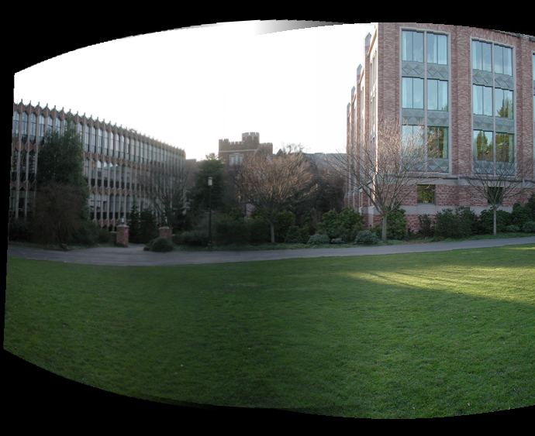
Another Example – Stitching Results with Cylindrical Projection

Slide 29
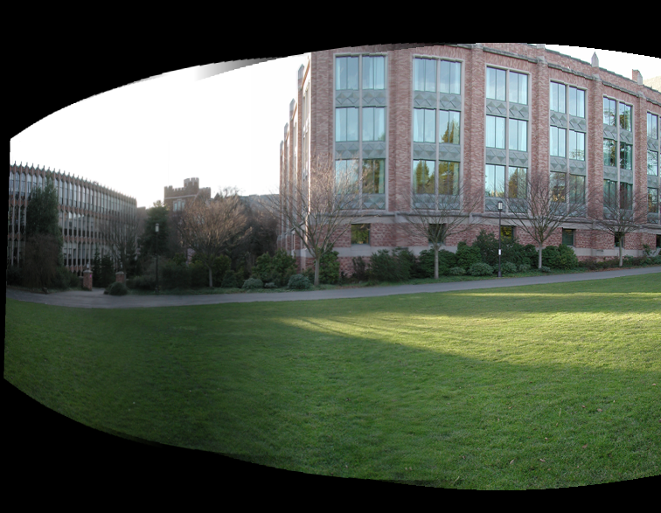
Another Example – Stitching Results with Cylindrical Projection

Slide 30
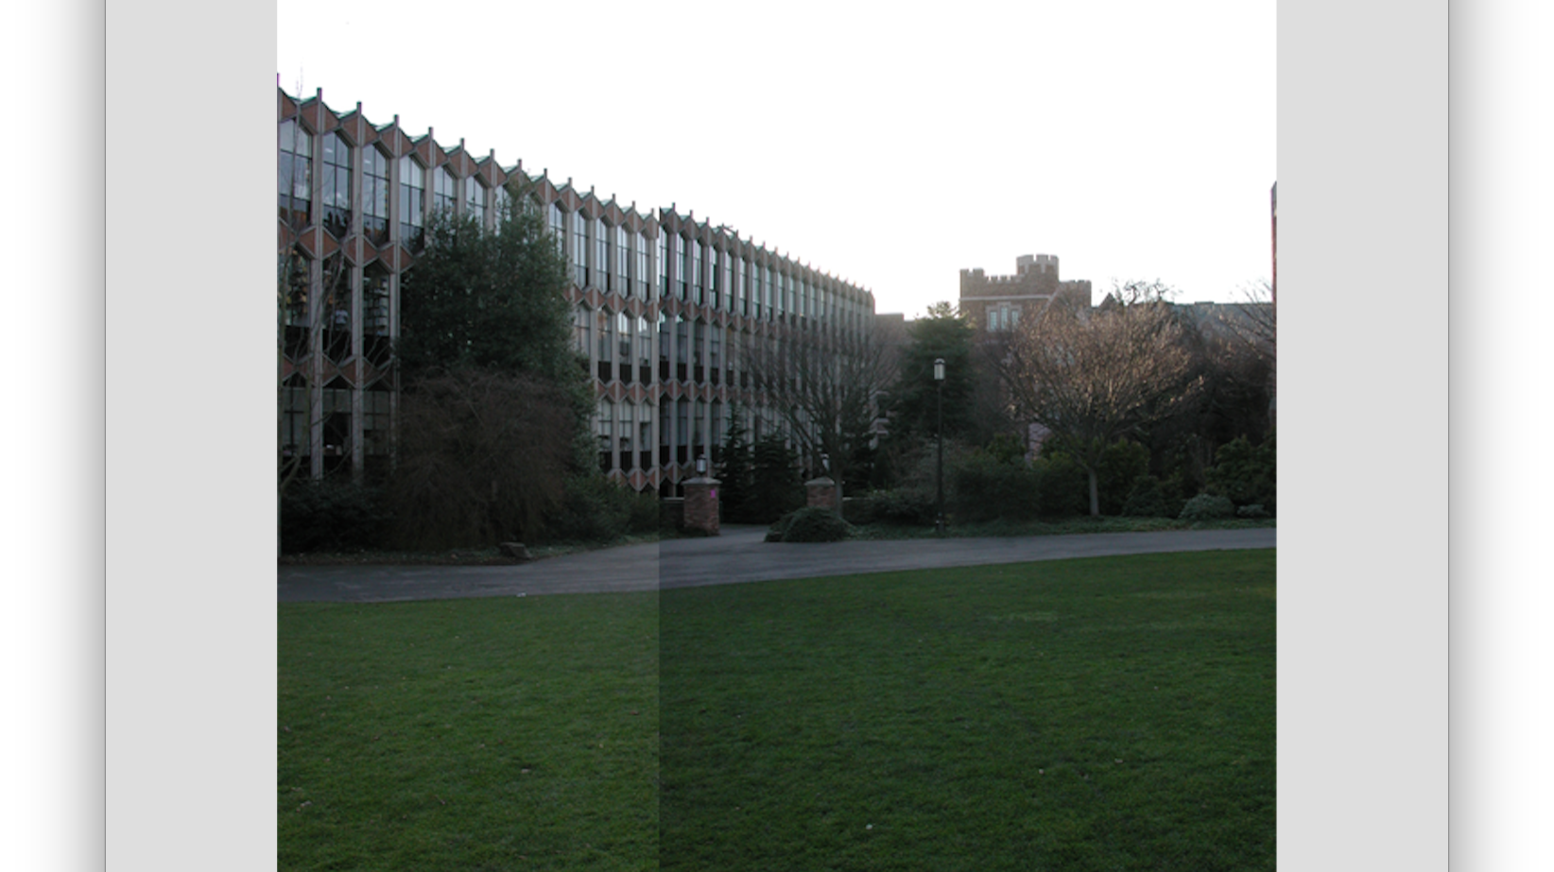
Simple Translation

Slide 31
Assignment Submission and Marking
1. Your submitted programs should be cylindricalProjection, harris, featureDescribe, distanceMatch, RANSAC and merge plus all the other related M-files (plus README.txt file).
2. You must include a README.txt file indicating the programming software (Octave or MATLAB) that you are using for this assignment. By default, we will grade your assignment with Octave if the README.txt file is missing.
3. Please also attach your stitching results for different groups of images when you submit the codes. If there are more than two images in the group, then your result image should be the stitching results for all the images within the group.

Slide 32

Assignment Submission and Marking
4. You must compress all your files with the following filename format: [your 8-digit student ID]_assign3.rar (or zip), e.g. 09654321_assign3.rar, into one file.
5. If your assignment compressed file has been submitted multiple times before the due date (including late submission date), the new version will replace the old version in marking.
6. Note that we take plagiarism seriously. You are allowed to discuss or share your idea to your classmate, but you are not allowed to share your code/pseudocode of your assignment. Please also follow the referencing skills at https://libguides.ust.hk/referencing/plagiarism to avoid plagiarism.
7. Marks would be deducted if there are any violations of the above requirements.

Slide 33

Octave package installation
If you are using Octave, you need to install the image package.
>> pkg install -forge image
And load the image package by
>> pkg load image

Slide 34
Live Demo

